Slide 1
Tank War
Group 212
Genius:
Di Wu(Jimmy)
Jiahao Zhou(Dios)
Xinyu Huang (Rick)

Slide 2
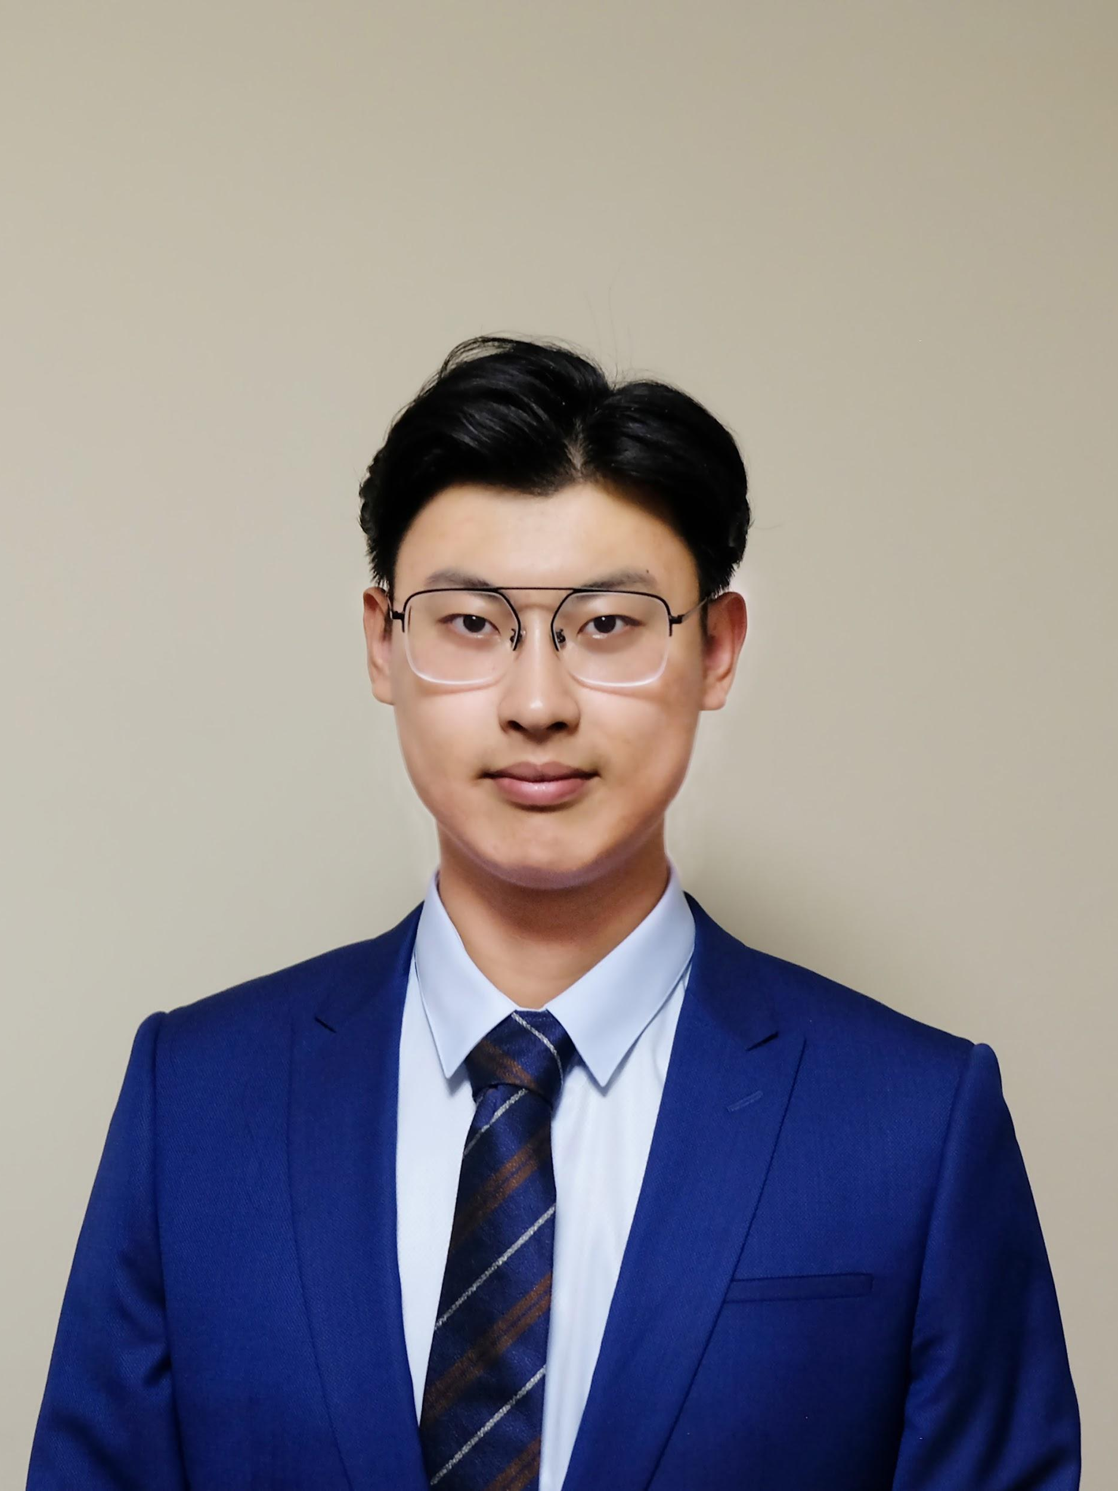
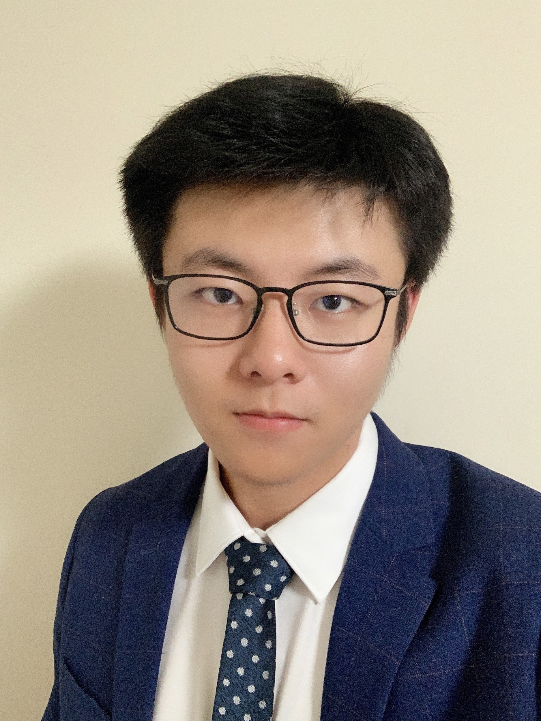
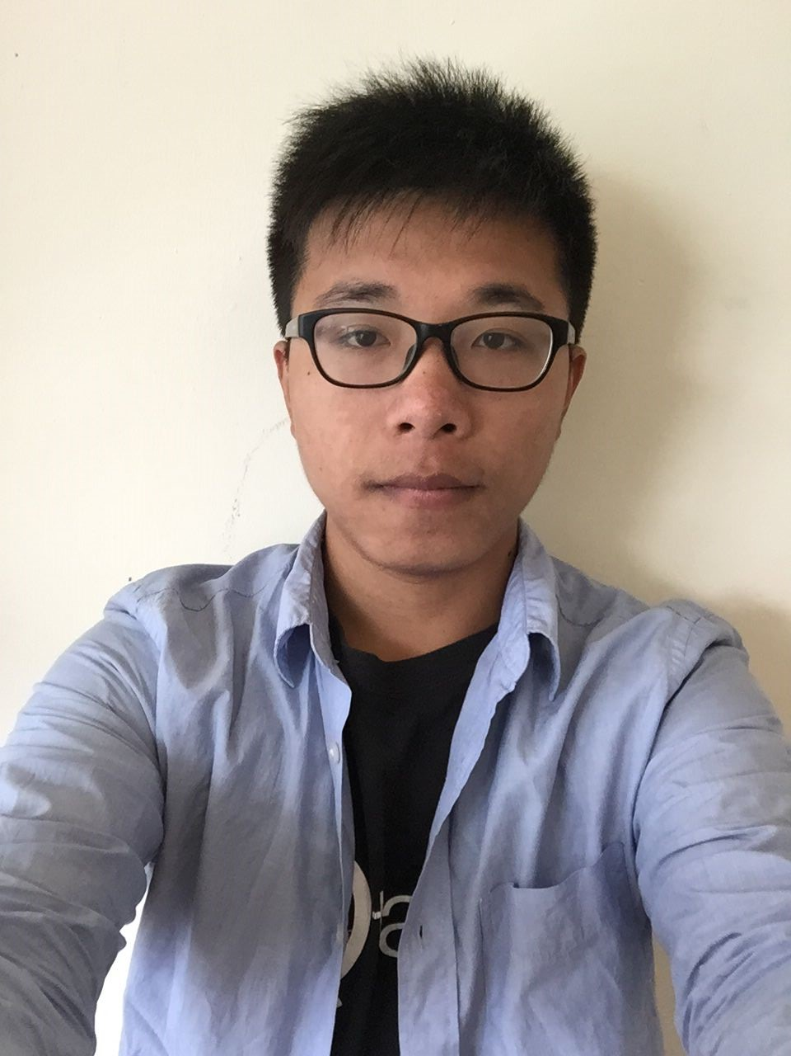
Team
Xinyu Huang (Rick):
Team Leader
Developer
Tester
Di Wu (Jimmy):
Developer
Designer
Jiahao Zhou (Dios):
Designer
Tester

Slide 3
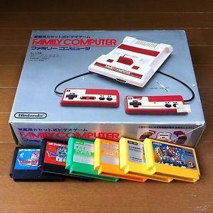
BackGround
20th Century
Classic family computer games
21st Century
Hard to access
Now
Redevelop “BattleCity”
One of the most popular games decades ago.
[1]
Notes:
一定要说出来Problem是什么

Slide 4
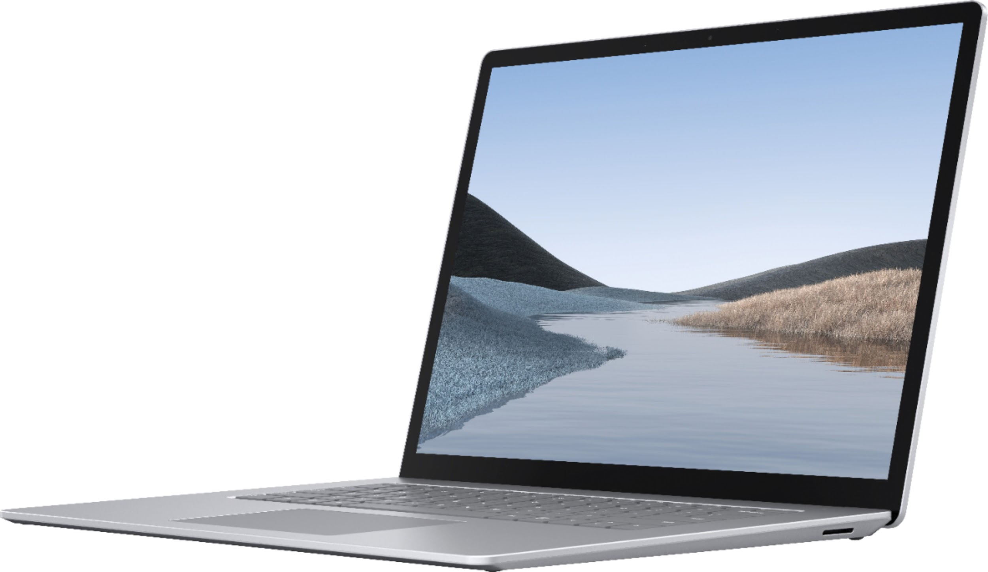
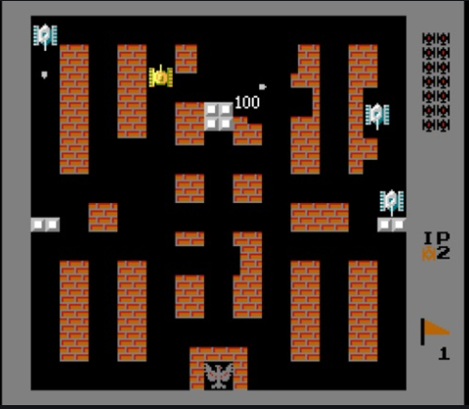
Purpose
Develop “BattleCity” for
Windows 7 and later
Mac OS X
Linux
Upgrade “BattleCity” to “TankWar”
Add new modes
Add new tanks
[2]
[3]
Notes:
这个就是我们给出的solution tank war

Slide 5
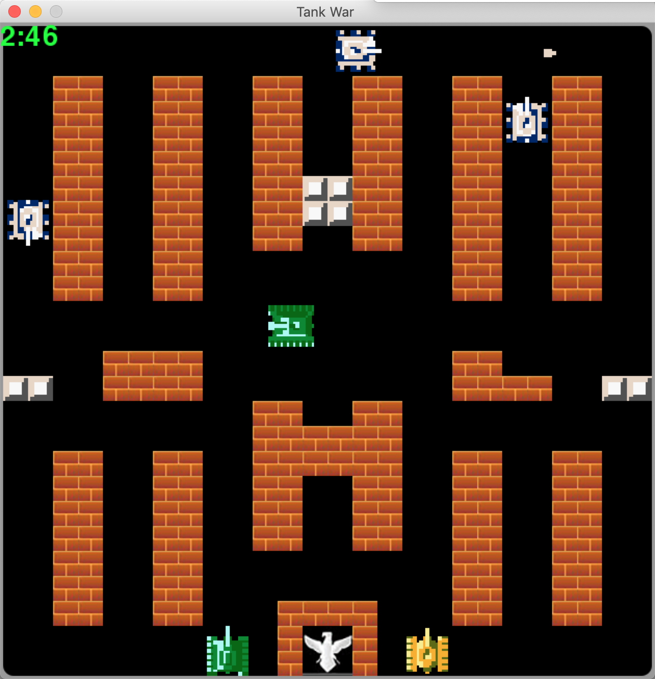
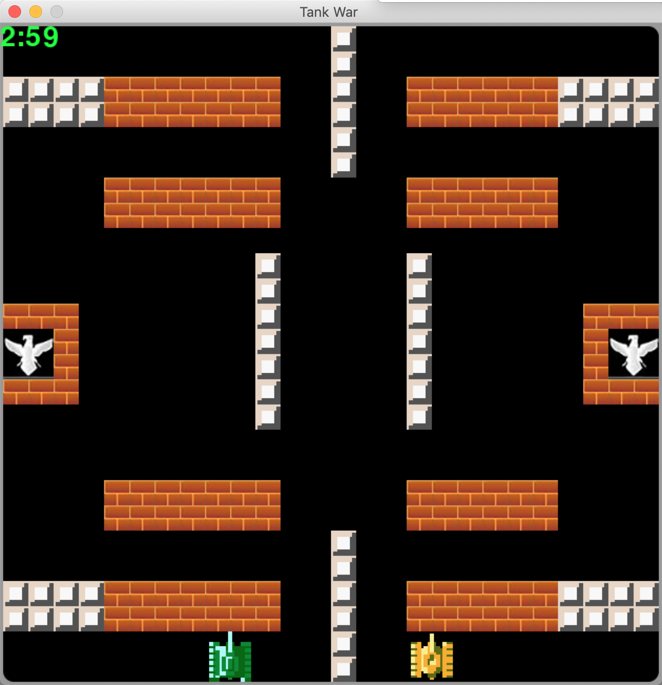
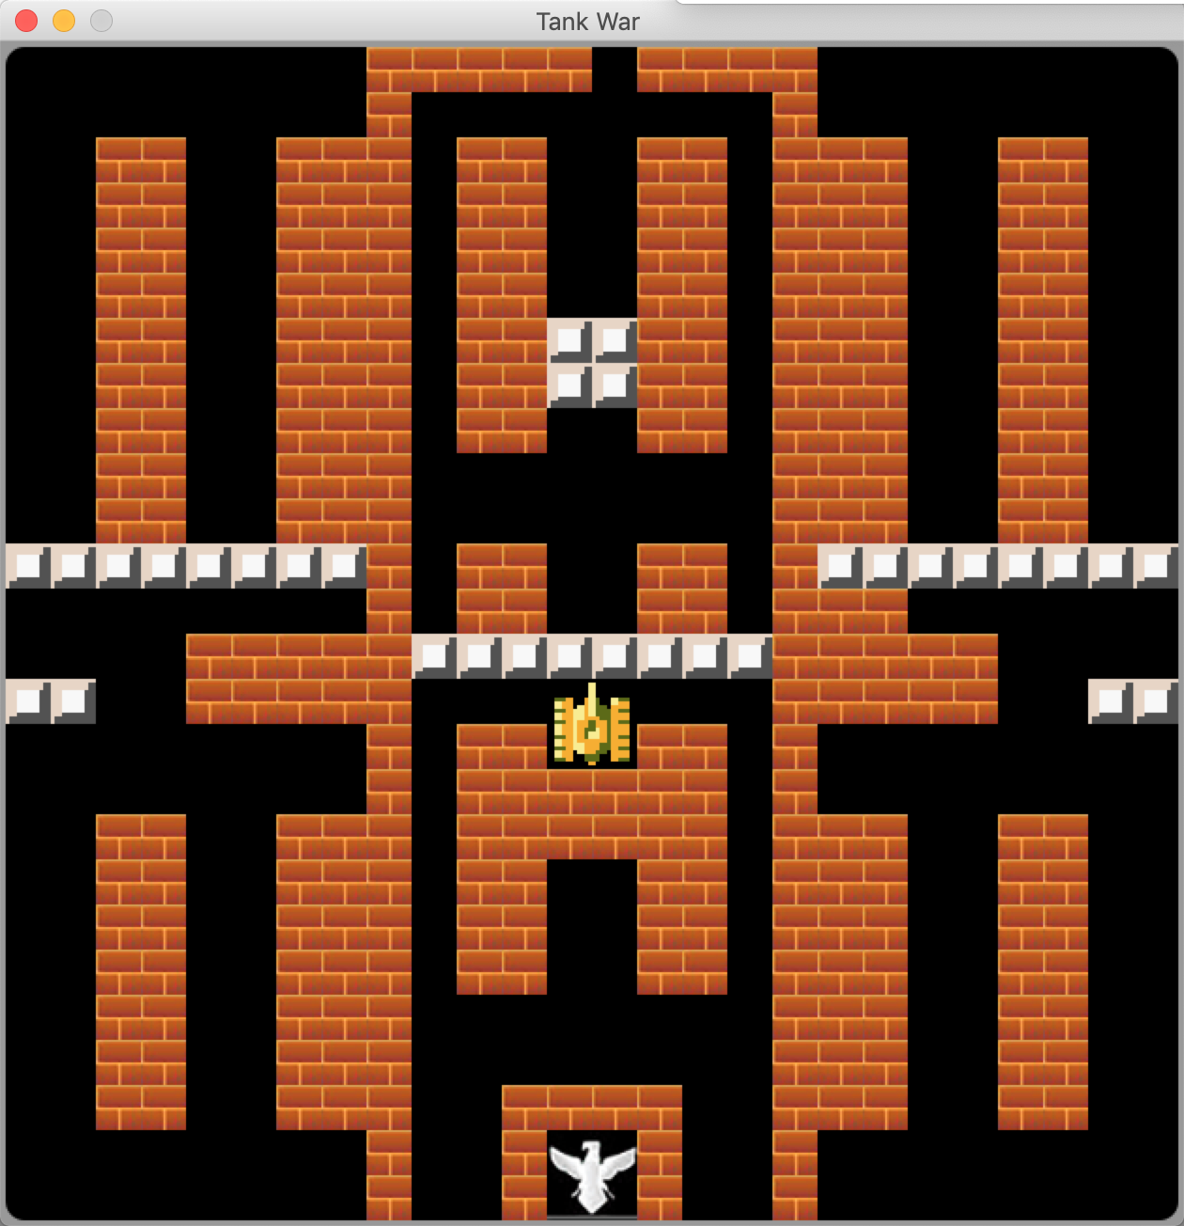
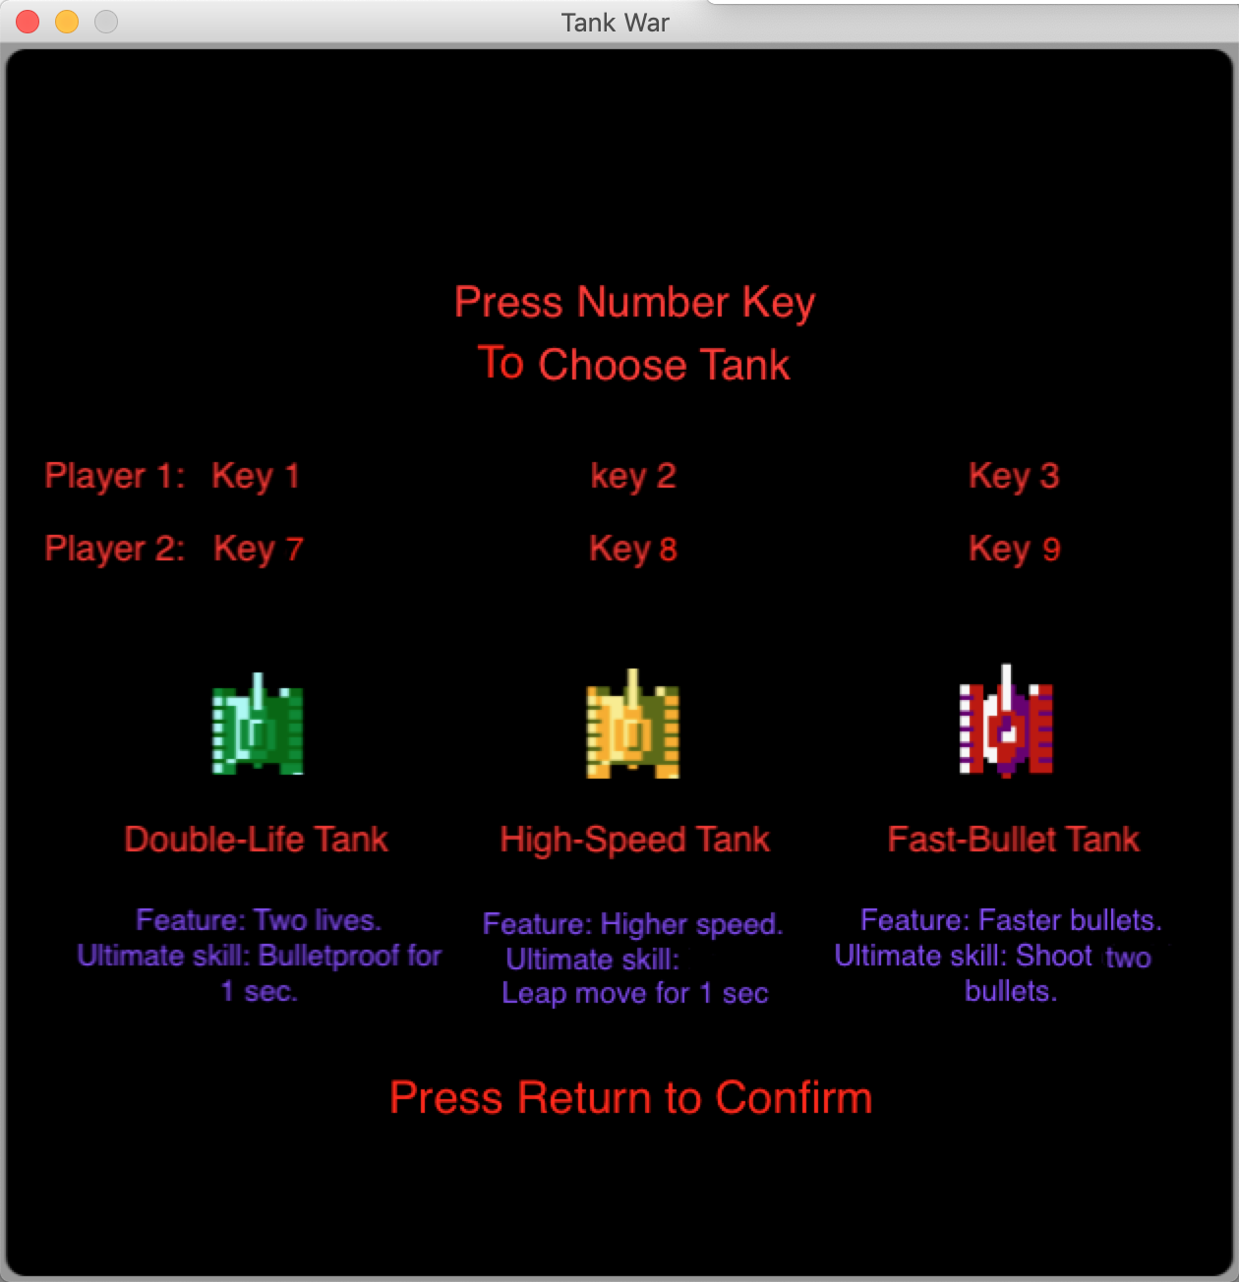
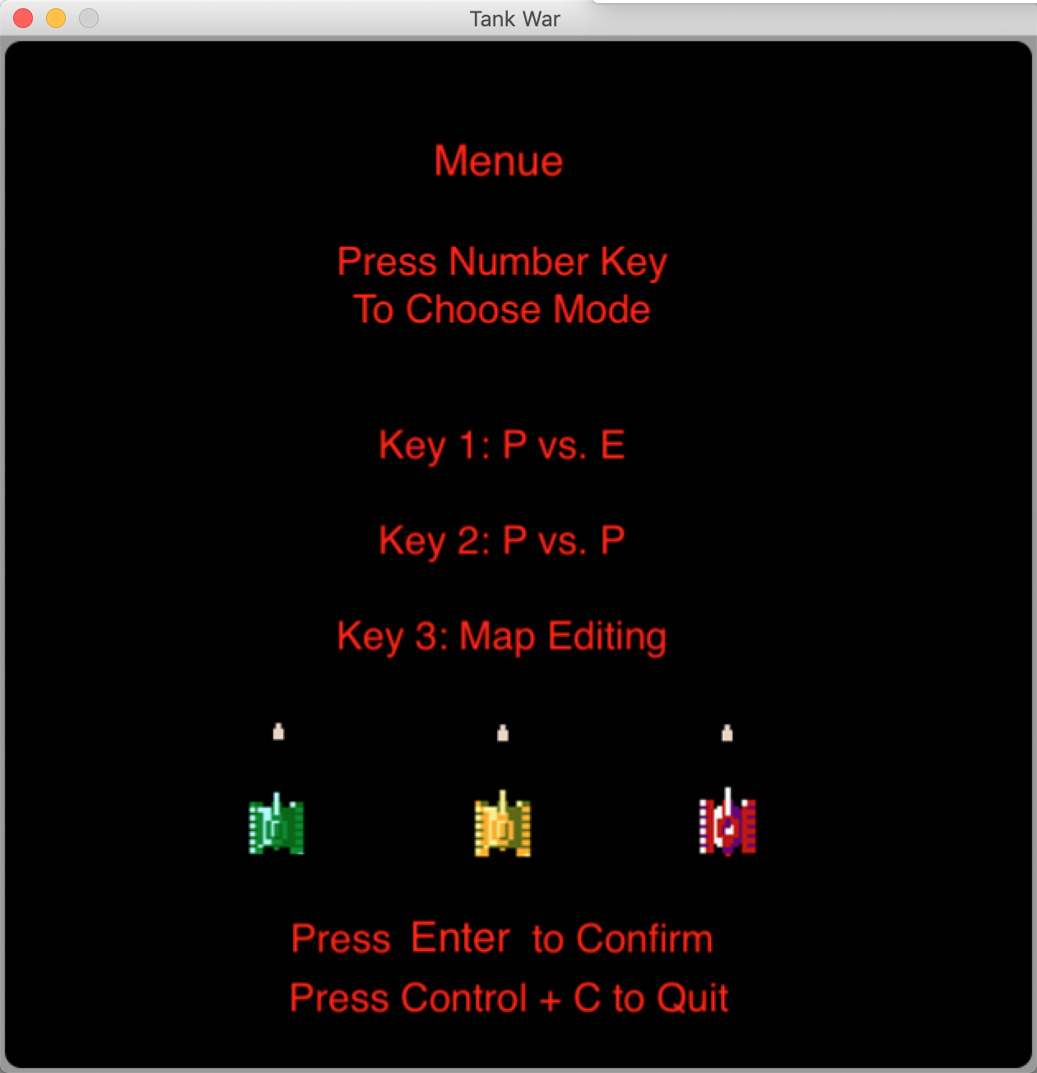
Scope
Develop “Tankwar” in python
New modes
PVP
Map editor
New tanks
Double life tank
High speed tank
Fast bullet tank

Slide 6


Technology
Python & Pygame
Git
Sublime Text
Python unittest
Coverage
Flake8
Doxygen
[4]
[5]
Notes:
Maintainability Doxygen & Flake 8 pep8
Well documented & commented

Slide 7
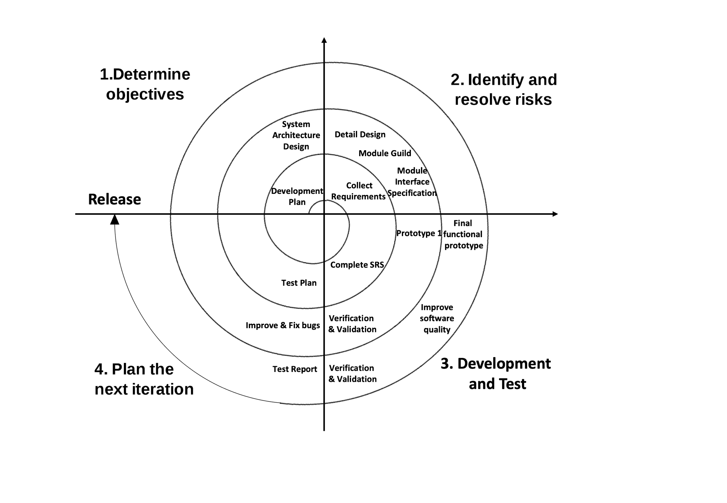
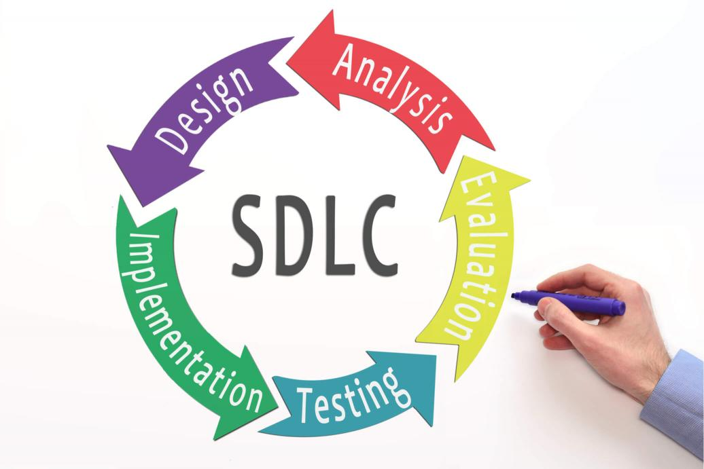
Design Process
Software Development Life Cycle (SDLC)
Spiral Model
Test-Driven Development (TDD)
[6]
Notes:
Strictly followed SDLC to develop our program in a short term.
Spiral Model to design our software and improve its qualities.
Test-Driven Development

Slide 8
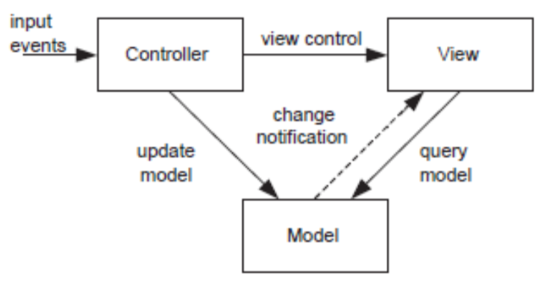
System Architecture
MVC
Model, View, Controller.
Suitable for our project.
Interactions with users.
Easy to collaborate.
[7]

Slide 9
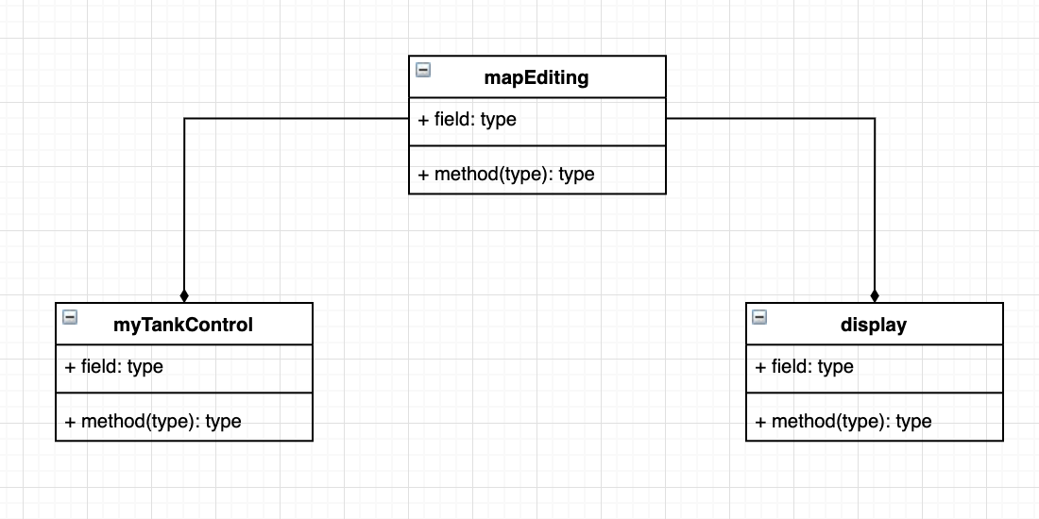
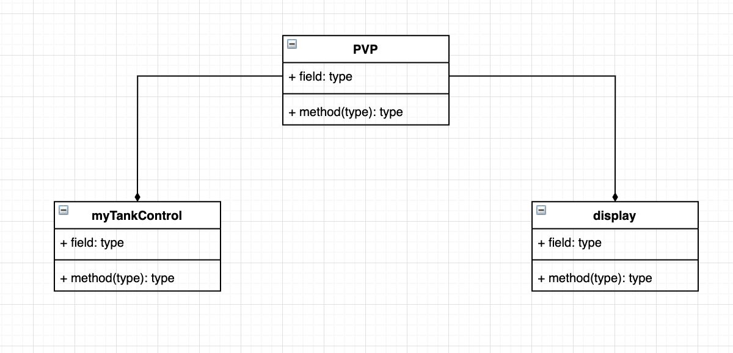
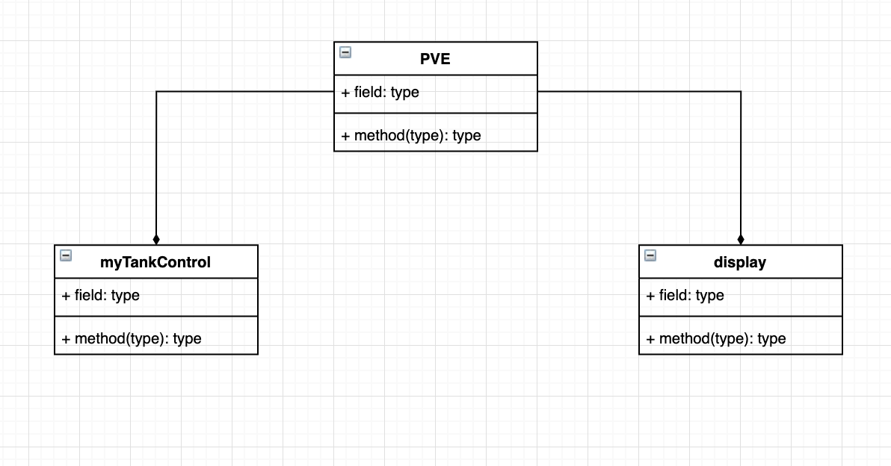
System Architecture
MVC

Slide 10
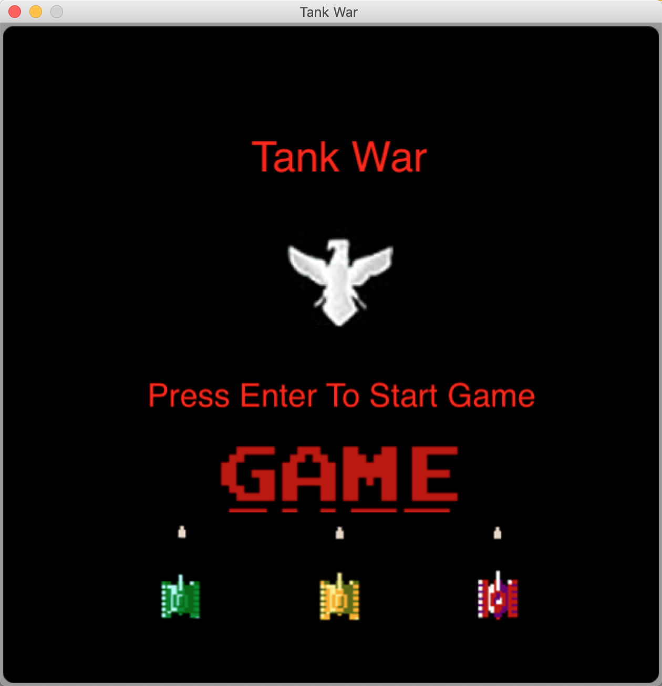
Software Quality
Reliability
Portability
Performance
Maintainability
Notes:
Reliability: 3 developers continuously play the game for 3 hours，no crash situation happens
Portability: Mac & Windows
Reusability:
Performance: We are expecting the response time to a user operation input less than 100 milliseconds. It only takes 32 milliseconds to do the response. Beyond our expectation
Maintainability: Since we made well comments, lots of design documentations, doxygen. Maintain would be benefit from these.

Slide 11
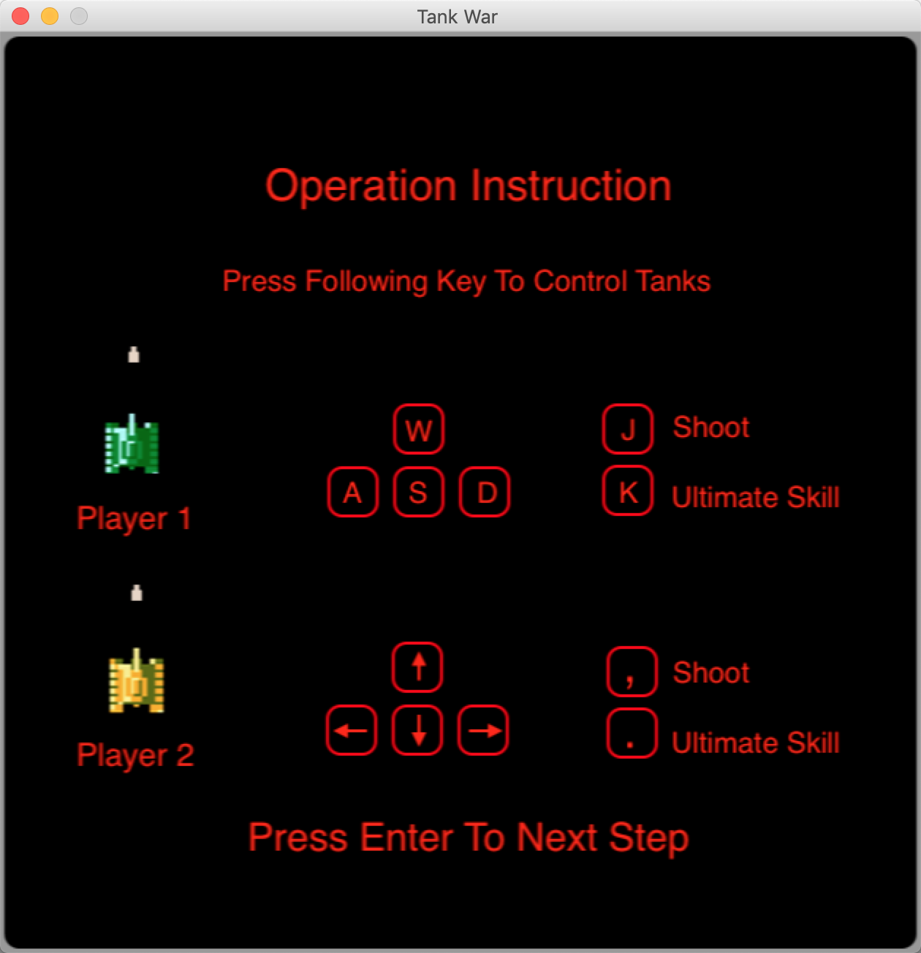
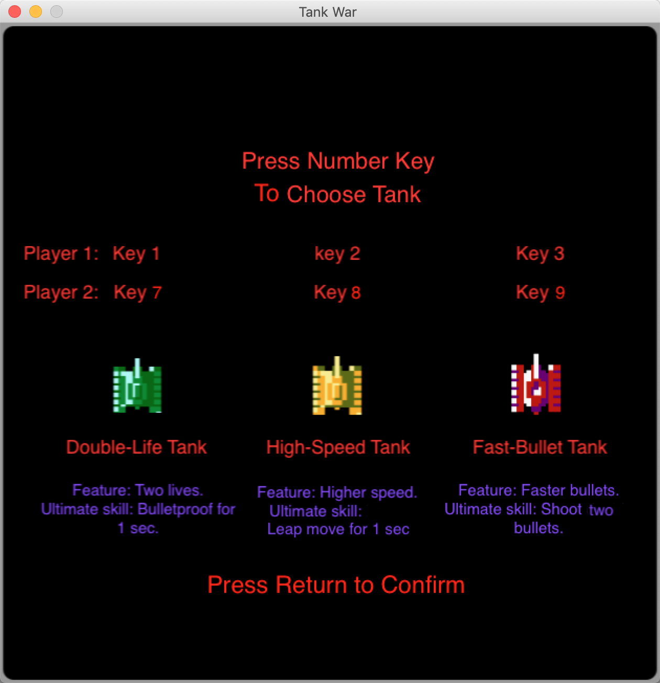
Software Quality
Usability
Robustness
Notes:
Usability:
Robustness: Use pygame key press feature to take the user input. Only the expected key press could be identified as an input, which could avoid unexpected arguments. Robustness of the software is guaranteed by the well design decision.

Slide 12
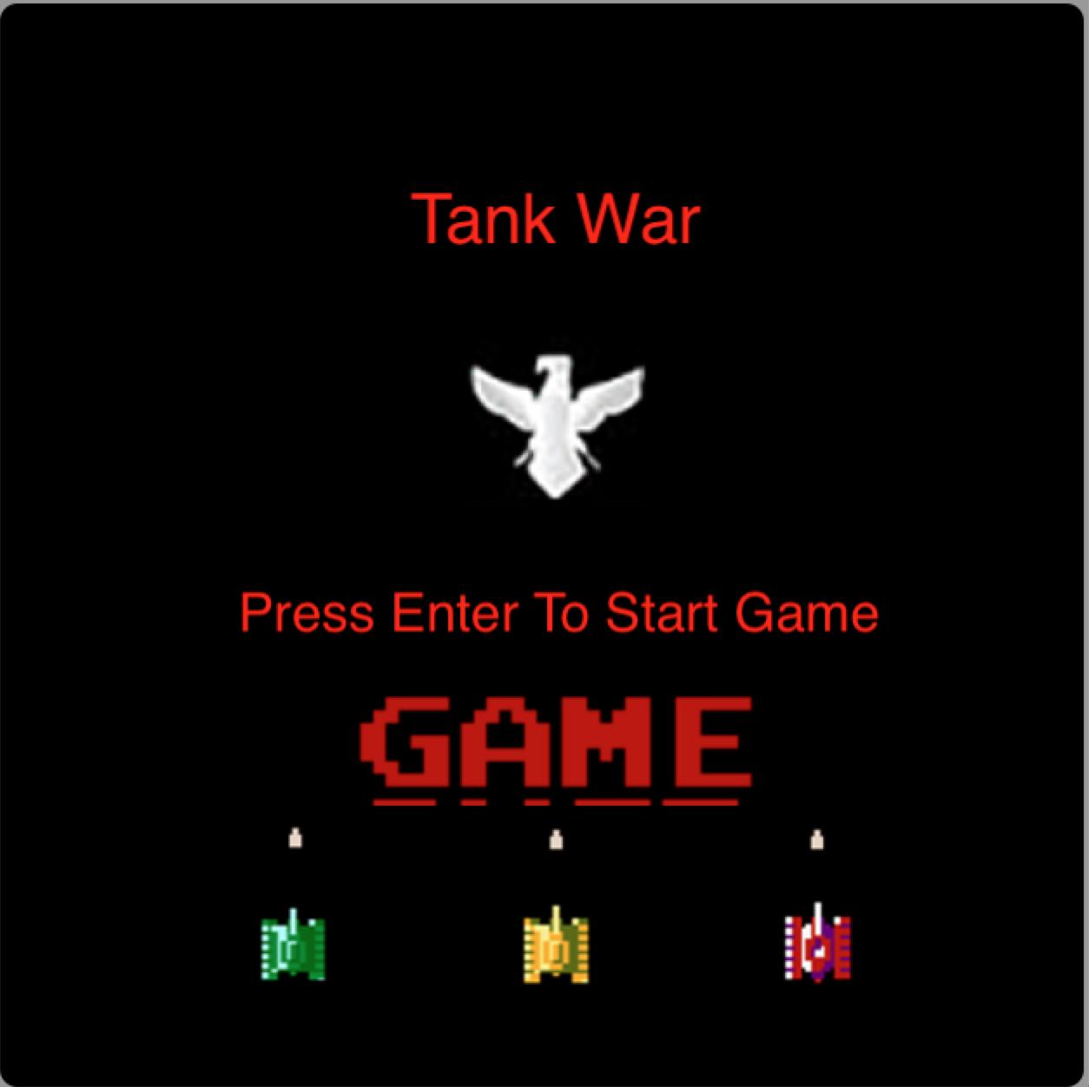
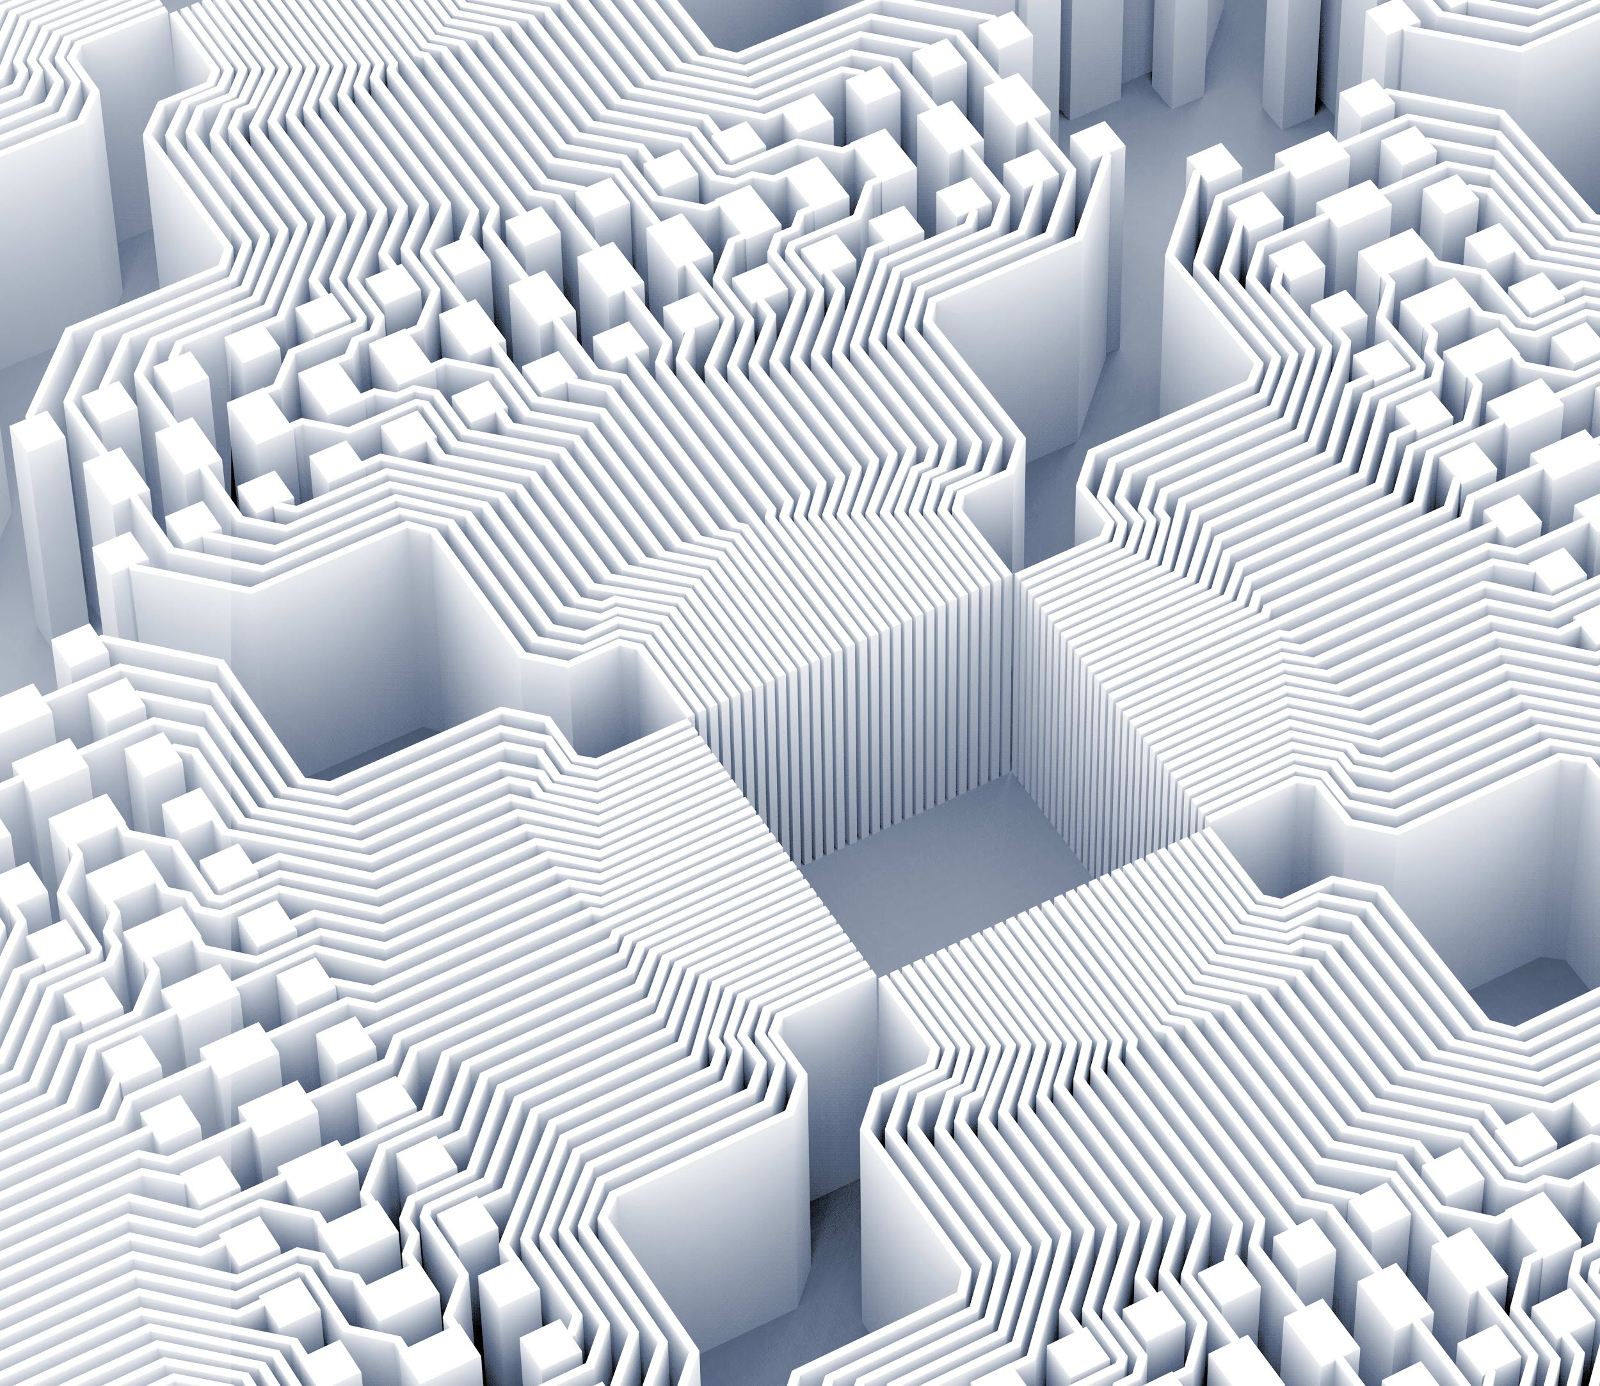
Demo Time

Slide 13

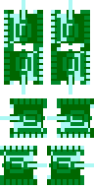
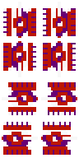
Future Feature
More types of landforms
More types of tanks
Game addiction Prevention

Slide 14
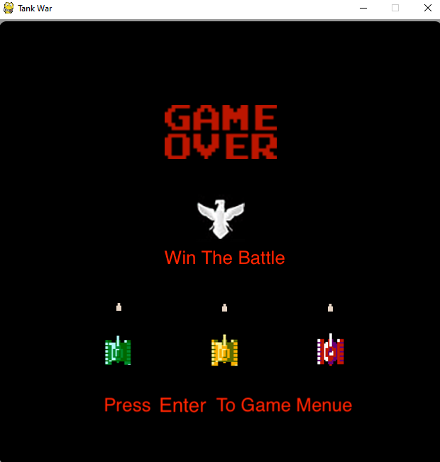
Conclusions
Upgraded game “TankWar”
New modes
New Tanks
High software qualities
More Fun in the Game

Slide 15
Any Question?

Slide 16
Image Reference
[1] https://www.pinterest.ca/pin/334392341066912698
[2] https://surface-pro.ru/2019/10/01/pervaya-utechka-renderov-microsoft-surface-on-arm-surface-pro-7-i- surface-laptop-3/
[3] https://mac.softpedia.com/get/Games/BattleCity-Tanks.shtml
[4] https://www.python.org/
[5] https://www.freecodecamp.org/news/an-introduction-to-git-for-absolute-beginners-86fa1d32ff71/
[6] https://www.roberthalf.com/blog/salaries-and-skills/6-basic-sdlc-methodologies-which-one-is-best
[7] 3XA3 Lecture Slide 9, page 19

Slide 17
Thank you!

